Slide 1
Restaurant DB
By: Todd Kahler, Jimmy Lau

Slide 2
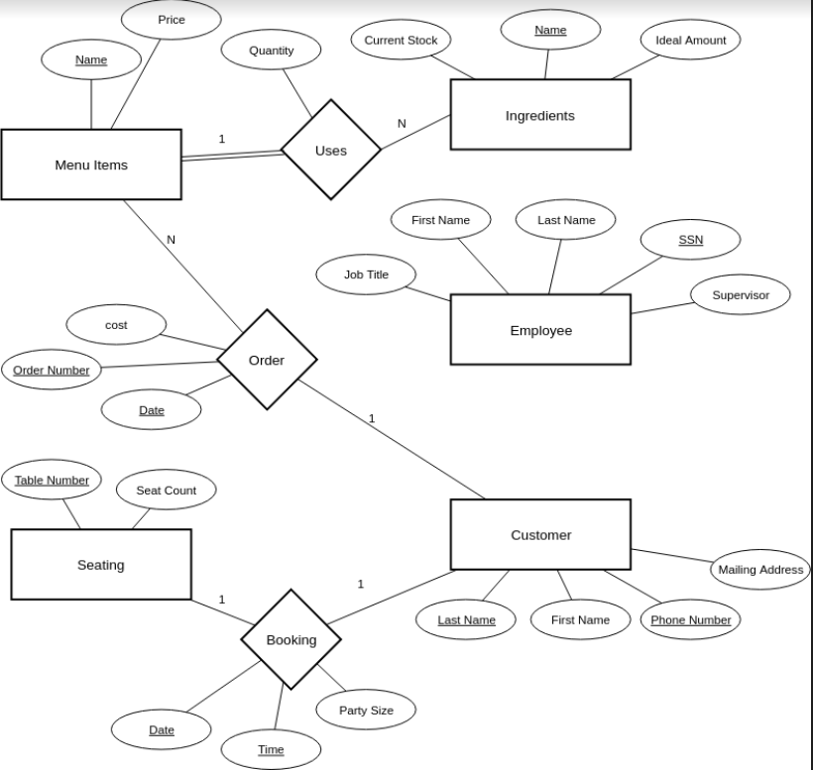
ER Diagram

Slide 3
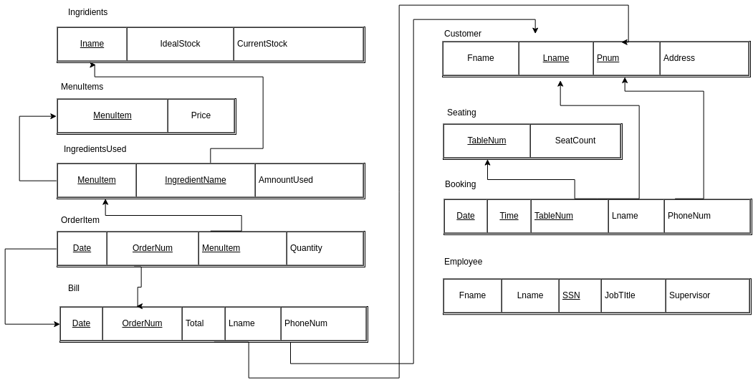
Relational Data Model

Slide 4

Relation: IngredientUsed
Keys: MenuItem, IngredientName
FD: {MenuItem, IngredientName} → {AmountUsed}
NF: BCNF

Slide 5

Relation: OrderItem
Keys: Date, OrderNum, MenuItem
FD: {Date, OrderNum, MenuItem} → {Quantity}
NF: BCNF

Slide 6

Relation: Bill
Keys: Date, OrderNum
FD: {Date, OrderNum} → {Total, Lname, PhoneNum}
NF: BCNF

Slide 7

Relation: Booking
Keys: Date, Time, TableNum
FD: {Date, Time, TableNum} → {Lname, PhoneNum}
NF: BCNF

Slide 8
DEMO
SQLite3

Slide 9
Evaluation
Good: Planning, Delegation
Bad:Time Management
Future: Focus on design, Theme

